Slide 1
UofT Engineering Finance Club Energy and Mining Sector
Yum! Brands Inc.
(NYSE: YUM)
Lead Analyst: Alex Lee

Slide 2

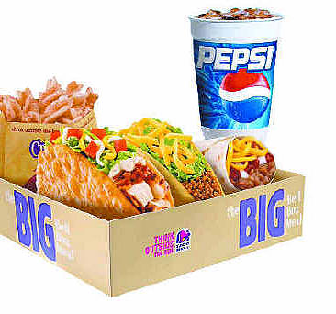
Company Description
Initially Tricon Global, created in 1997 as a spin-out from PepsiCo, owner of KFC, Pizza Hut and Taco Bell. Changed to Yum! Brands in 2002
Yum! Brands has a lifetime contract with PepsiCo, they serve Pepsi beverages
US growth has slowed due to market saturation
Targeting international growth, most worldwide units as of 2010
Introduction
Description
Key Drivers
Valuation
Conclusion
Notes:
2

Slide 3
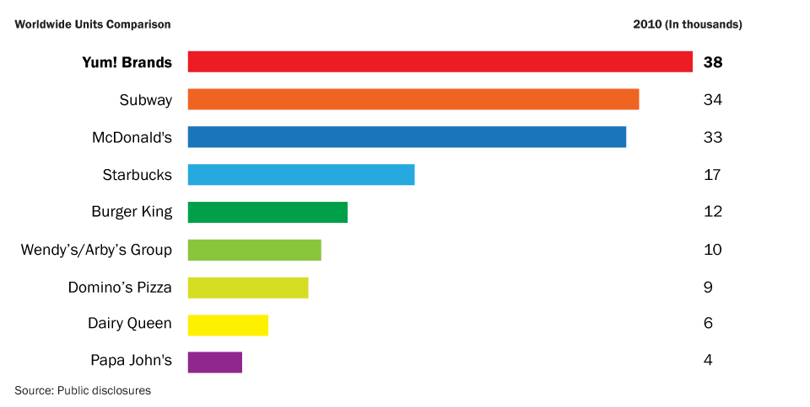
Company Description
Introduction
Description
Key Drivers
Valuation
Conclusion
Notes:
3

Slide 4
Company Description
Headquarters: Louisville, Kentucky, United States
Operates in over 110 countries and territories outside the US and China
378,000 employees
China operating profit more than doubled in the last 3 years to $755 million
24 years since first KFC in China, built up their supply chain and distribution system quickly
Introduction
Description
Key Drivers
Valuation
Conclusion
Notes:
4

Slide 5
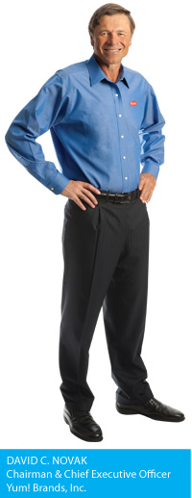
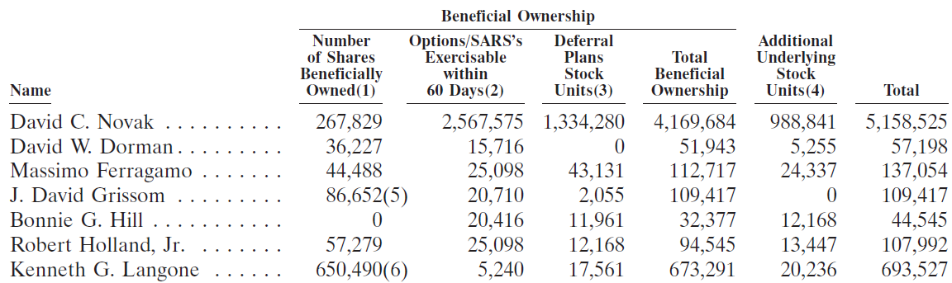
Chairman & CEO
Chairman & CEO: David C. Novak
Also served as Chief Operating Officer of Pepsi-Cola North America
Has been an Independent Director of JPMorgan Chase & Co. since 2001
Introduction
Description
Key Drivers
Valuation
Conclusion
Notes:
5

Slide 6

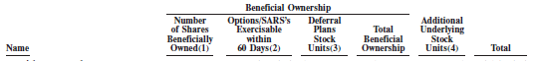
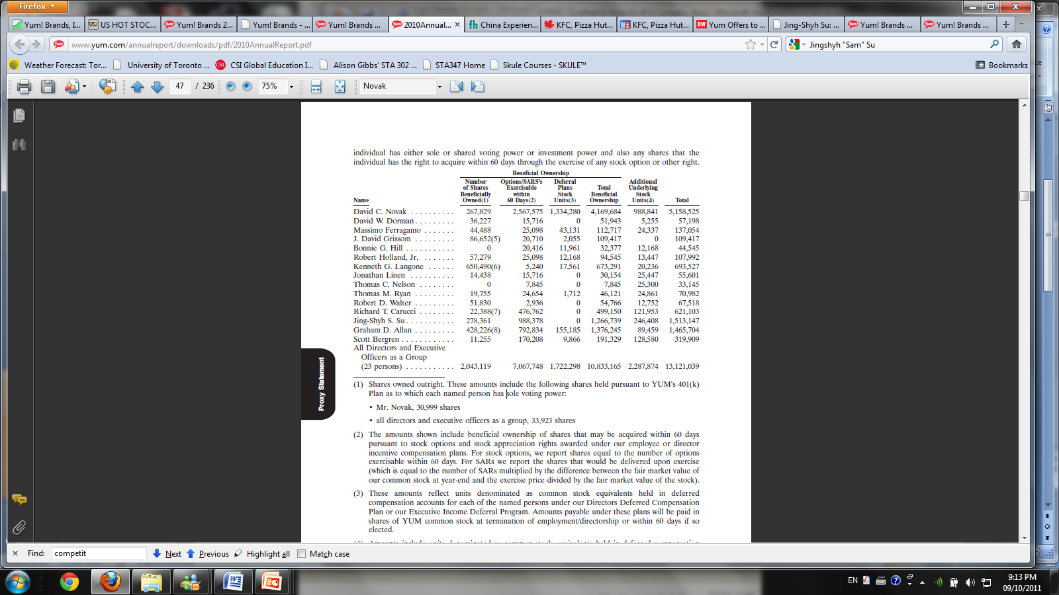
Chairman & CEO, China
Chairman & CEO of Yum! Brands China Division: Jingshyh "Sam" Su
Appointed May, 2010
Also Vice Chairman of the Board at Yum! Brands
Previously served as President of the China Division since 1997
Introduction
Description
Key Drivers
Valuation
Conclusion
Notes:
6

Slide 7
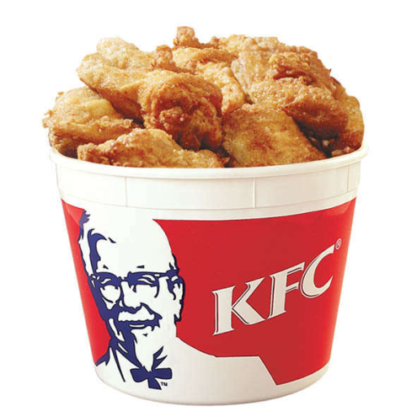
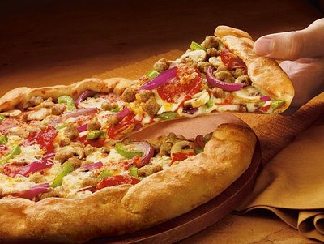
Basic Figures
Stock Price: 53.74 (49.24)
EPS: 2.55
P/E Ratio: 21.04
Beta: 0.98
Market Capitalization: 24.75B
Introduction
Description
Key Drivers
Valuation
Conclusion
Notes:
7
As on February 2

Slide 8
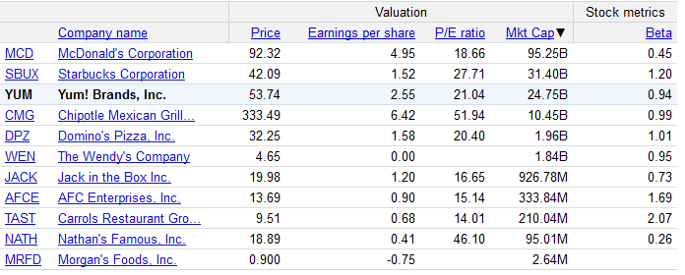
Competitors
Introduction
Description
Key Drivers
Valuation
Conclusion
Notes:
8

Slide 9
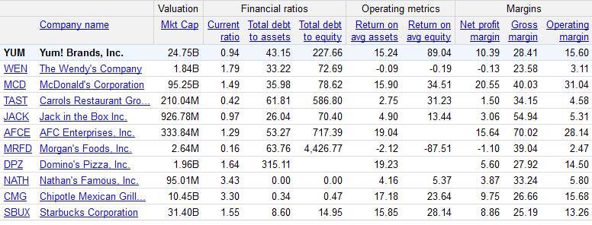
Additional Ratios
High leverage: S&P’s (BBB-), Moody’s (Baa3)
Comparatively high Return on Equity
Introduction
Description
Key Drivers
Valuation
Conclusion
Notes:
9
As on February 2

Slide 10
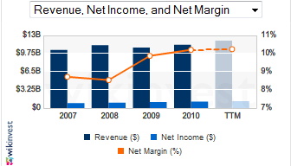
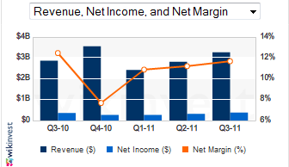
Revenue Growth
Annual Data
Quarterly Data
Fiscal third-quarter profit grew 7.3% thanks to continued strong sales in Chinese market
Higher costs and weak U.S. demand erased much of the company's international growth
Introduction
Description
Key Drivers
Valuation
Conclusion
Notes:
10

Slide 11
News & Media
J.P. Morgan recently reported YUM as Overweight, with a $65 target. Also YUM better for short term.
Taco Bell (60% of US earnings) lawsuit closed in April
3700:1300 = YUM:MCD units in China
MCD plans to open a restaurant every day in China for the next three to four years
YUM looking to buy China’s Little Sheep chain (now owns 27%)
China’s economy slowing but inflation still rising
Introduction
Description
Key Drivers
Valuation
Conclusion
Notes:
11

Slide 12
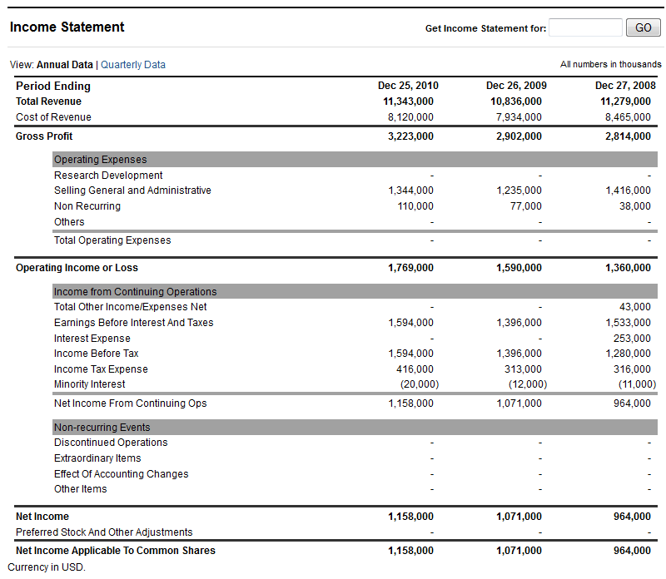
Financial Statements
Introduction
Description
Key Drivers
Valuation
Conclusion
Notes:
12

Slide 13
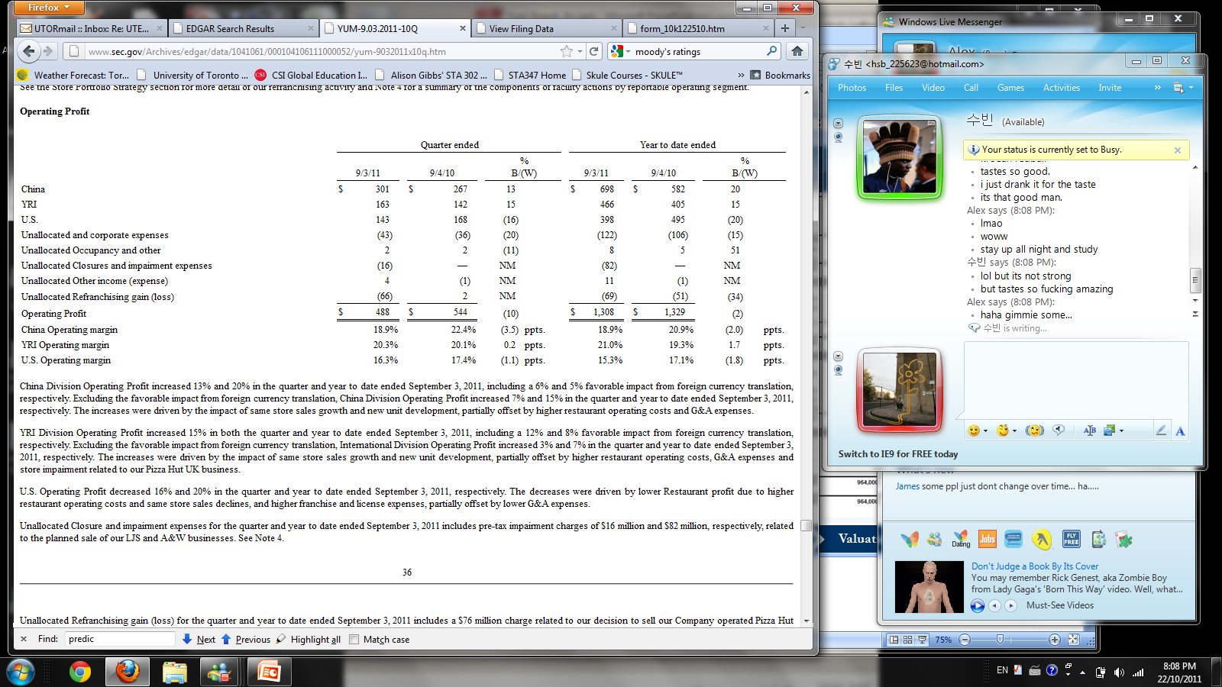
Financial Statements
Operating Profits
Introduction
Description
Key Drivers
Valuation
Conclusion
Notes:
13

Slide 14
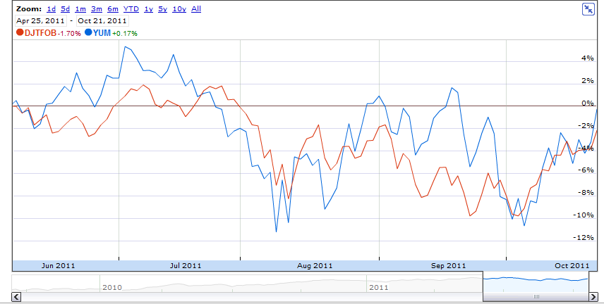
Macro Effects
Dropped significantly in last few months, similar to market
Introduction
Description
Key Drivers
Valuation
Conclusion
Notes:
14

Slide 15
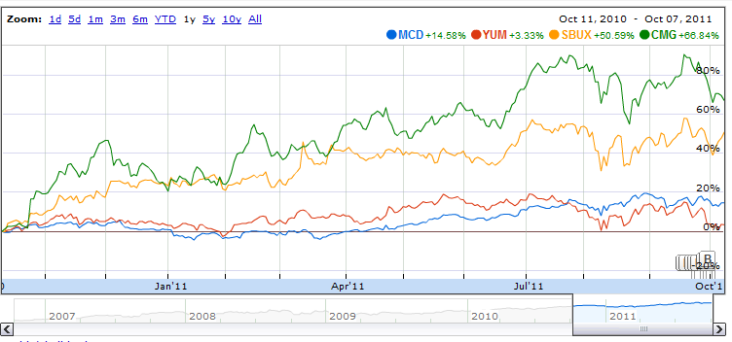
Competition (1yr)
Introduction
Description
Key Drivers
Valuation
Conclusion
Notes:
15

Slide 16
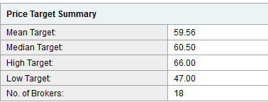
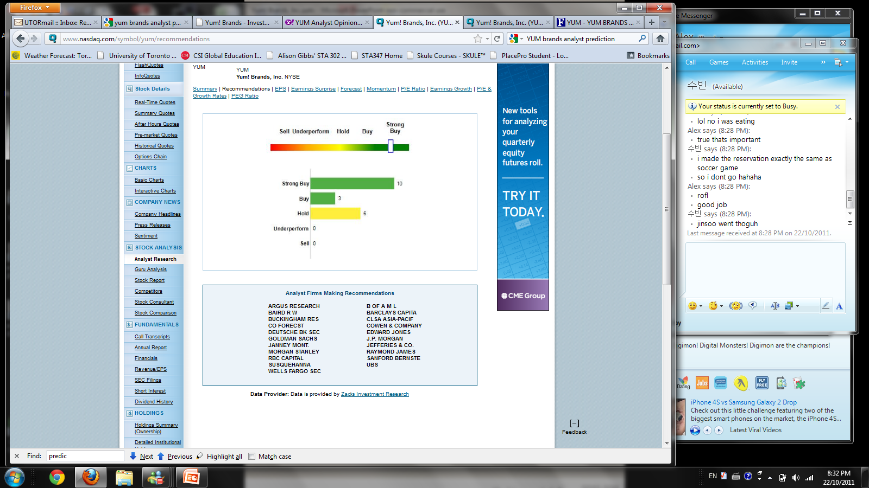
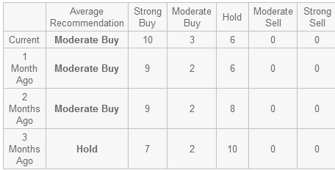
Analyst Predictions
Introduction
Description
Key Drivers
Valuation
Conclusion
Notes:
16

Slide 17
Team Recommendation
$60
12 Month Price Target:
< $50
Appropriate Entry Price:
Top Three Reasons to BUY:
1
Current leader in China
2
3
Current low price
Expected growth
Introduction
Description
Key Drivers
Valuation
Conclusion
Notes:
17

Slide 18

Questions or Comments?
Notes:
18

